Slide 1
MODERN LANGUAGES
With
Professor Stephen Hutchings
By Good Studio

Slide 2
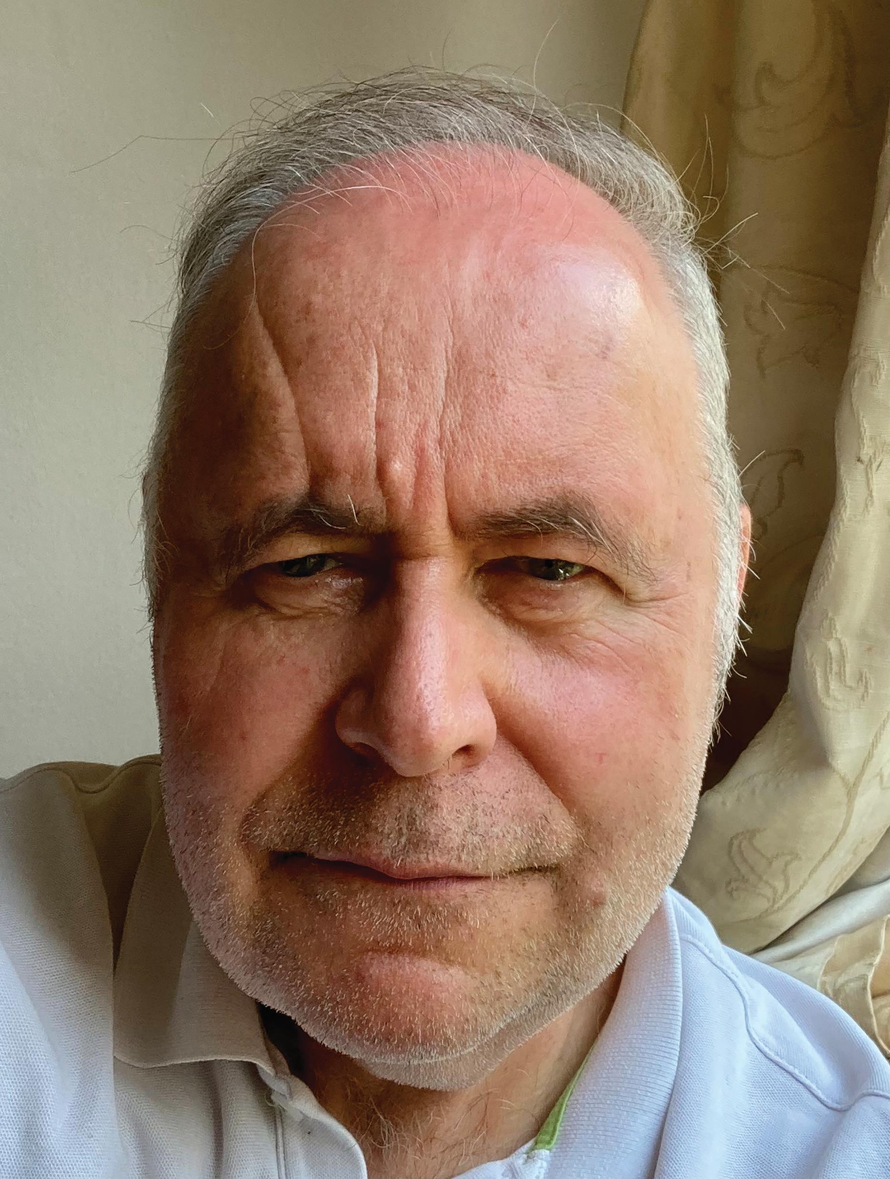
MEET STEPHEN
Professor Stephen Hutchings, based at the University of Manchester in the UK, has been leading a modern languages research programme exploring the relationship between language and community.
Learn more about his research…

Slide 3
LANGUAGES IN TODAY’S WORLD
In many ways, our world is getting ‘smaller’. Globalisation facilitates interactions that are no longer restricted by borders or distance and brings people from different backgrounds together. Ask yourself:
How does language operate within this modern era?
To what extent are communities defined by language?
To what extent do geographical boundaries affect our sense of belonging?
What impact do global changes have on languages?
By vladayoung

Slide 4
“CROSS-LANGUAGE DYNAMICS: RESHAPING COMMUNITY”
By denisismagilov
Digital technologies and unprecedented global population movements have transformed the relationships between individuals and the communities they belong to (national, local, religious and other), between those communities, and between communities and nations.
It is impossible to understand the processes involved in these shifts and changes without studying language’s central role in creating and transcending the boundaries that define communities.
Stephen’s research aims to do just this.

Slide 5
“CROSS-LANGUAGE DYNAMICS: RESHAPING COMMUNITY”
This a collaborative project based on three strands, led by three different universities in the UK:
The Multilingual strand – led by Professor Yaron Matras of the University of Manchester
The Transnational strand – led by Professors Andy Byford and Anoush Ehteshami at Durham University
The Translingual strand – led by Professor Catherine Davies at the School of Advanced Study, University of London
By vladayoung

Slide 6
COLLABORATION
By denisismagilov
The team has worked with many people, including:
within the UK, other nations, and across national and linguistic boundaries
foreign policy makers, arts organisations, local authorities, schools and community groups.
The team’s work has been wide and varied.
“We have worked together with our partners on joint initiatives that include a city-wide celebration of linguistic diversity in Manchester and a play that explores the experiences of cancer sufferers across the Arabic-speaking world. “ – Stephen

Slide 7
HIGHLIGHTS INCLUDE:
Raising the profile of modern languages
Addressing key societal issues associated with societal cohesion, health, conflict and cultural diplomacy
Re-establishing modern languages as one of the foremost humanities disciplines
Forging partnerships with stakeholders
Demonstrating the importance of linguistic diversity
Confronting negative perceptions of a subject ‘in decline’
By Good Studio

Slide 8
TALKING POINTS
In what way do you think digital technologies are changing relationships between individuals and communities?
What role do you think language has in creating communities?
Before you learn more about the project, what do you think the three strands of multilingual, transnational and translingual explored?
By Good Studio

Slide 9
THE MULTILINGUAL
By Good Studio

Slide 10
“Many of our large, global cities are characterised by increased linguistic diversity and this was the focus of our multilingual strand.”
- Stephen
By Good Studio

Slide 11
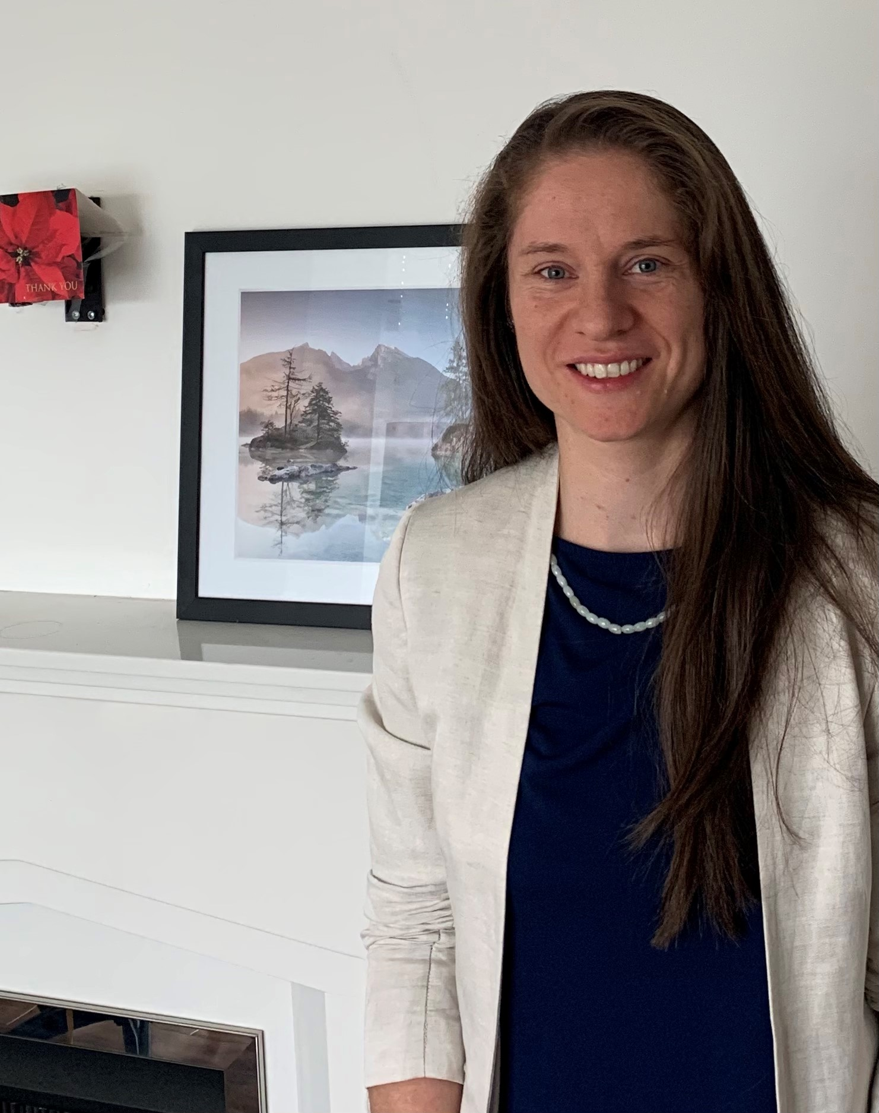
DR LEONIE GAISER ROLE ON THE PROJECT: PHD STUDENT AND RESEARCH ASSISTANT CURRENT ROLE: LECTURER IN LINGUISTICS, THE UNIVERSITY OF MANCHESTER, UK
“Our research explores how speakers of ‘heritage’ languages maintain their languages and dialects in the linguistically diverse city of Manchester, and how language can help create a sense of community in the diaspora setting. One of our research interests is to learn more about the work of language supplementary schools, which teach heritage languages to children on the weekend. We have set up a support platform for supplementary schools to offer a range of activities for pupils and teachers.”

Slide 12
“We have worked with the Manchester Institute of Biotechnology and scientists from the University of Manchester to deliver interactive sessions in the languages taught at the schools.
Our enrichment sessions have included enzyme experiments and strawberry DNA extraction, led by multilingual scientists. Experiments are followed by hands-on activities for students and (typically multilingual) question and answer sessions.
Our sessions give children opportunities to experience their heritage language in the context of scientific experiments or museum exhibitions, and in interaction with university staff. The sessions expand pupils’ vocabulary in the heritage language. Meeting university researchers who speak their language enhances students’ confidence in their language skills and their complex, multi-layered identities. Our research has offered insights into the various ways in which language users maintain their languages and acquire new ones.
My doctoral research has shown that maintaining heritage languages is anything but self-segregating. These languages are relevant in the present-day UK context and for its global future, and supplementary schools help children turn their heritage into valuable skills.”

Slide 13
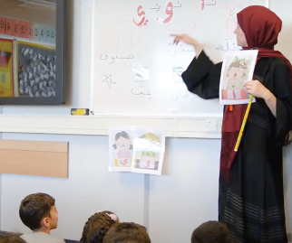
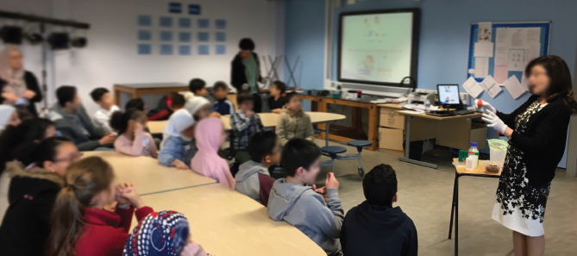
Part of Leonie’s research was to learn more about the work of language supplementary schools.
A language supplementary school in Manchester. The team advises you get involved in language-related projects or organisations as early as possible. Such opportunities will allow you to gain valuable experience and skills, and explore the richness and complexities of languages and ‘communities’ on your doorstep.

Slide 14
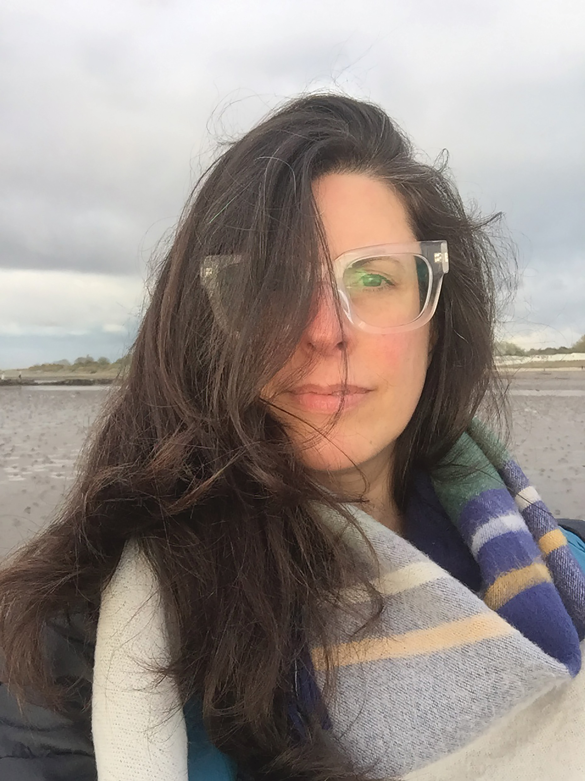
DR MARÍA SOLEDAD MONTAÑEZ ROLE ON THE PROJECT: RESEARCH FELLOW, COMMUNITY ENGAGEMENT IN THE LATIN AMERICAN COMMUNITY IN LONDON CURRENT ROLE: VISITING FELLOW, THE INSTITUTE OF MODERN LANGUAGES RESEARCH, SCHOOL OF ADVANCED STUDY, UNIVERSITY OF LONDON/LECTURER IN SPANISH, UNIVERSITY OF GLASGOW, UK
“I worked with Southwark Council to explore new tools, resources and opportunities for collaboration and engagement between the Latin American groups in Southwark and the wider community. I co-designed and co-delivered Cartonera workshops for young Latin Americans. Cartoneras (also known as cardboard publishers) is a unique grassroots Latin American publishing phenomenon, which offers alternative forms of community engagement, activism and social change… within vulnerable and marginalised communities.”

Slide 15
“The Cartoneras Creative Engagement Project explored notions of community, identity and language through a series of workshops, from creative writing to book making with young Latin Americans. The idea was to publish the voices of young Latin Americans in London as the UK was preparing to exit the EU.
Creativity plays a vital role in community engagement in cross-cultural contexts. Creativity should be understood as a source of free expression, adaptability and innovation, and an alternative to more bureaucratic forms of consultations.
The Cartoneras workshops allowed the young people to develop a better sense of identity and belonging, as the motto chosen by them was ‘to work as a team’.
The Latin American community is diverse – ethnically, linguistically, culturally, and geographically distinctive from each other – Latin American is far from a homogenous concept. Language barriers play a role in preventing many Latin Americans from accessing key services.
My research is community-focused, so a typical day would involve lots of talking with different stakeholders, from formal and semi-structured interviews to meetings, and delivering community projects myself. Working on community engagement means that most of the research is done ‘on the ground’.”

Slide 16
TALKING POINTS
What role do you think language supplementary schools play in the community? Have you attended one? If so, how did it benefit you?
Why is it important for people to maintain their heritage language?
Why is creativity so important for community engagement and a sense of belonging?
In what way do you think language barriers play a role in preventing many Latin Americans from accessing key services?
By Good Studio

Slide 17
THE TRANSNATIONAL
By Good Studio

Slide 18
“The technological advances that are driving the most recent phase of globalisation have also reinforced the ability of speakers of single languages to communicate across national boundaries, strengthening ties across the Russian-speaking, Spanish-speaking and Arabic-speaking worlds, for example. These communities were studied within our transnational strand.”
– Stephen
By Good Studio

Slide 19
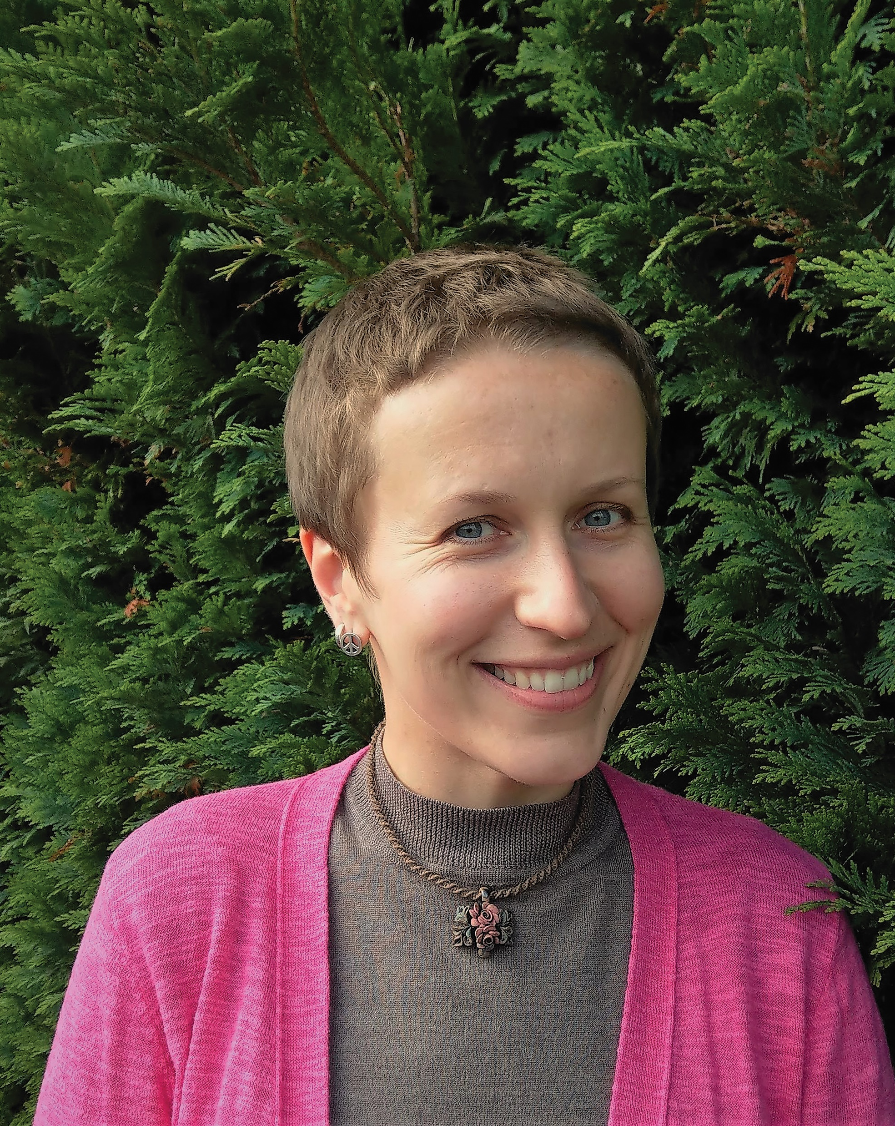
DR POLINA KLIUCHNIKOVA ROLE ON THE PROJECT: POSTDOCTORAL RESEARCH ASSOCIATE, ‘LANGUAGE BORDER: RUSSIAN IN FORMER SOVIET UNION MIGRATION’ CURRENT ROLE: ASSOCIATE LECTURER IN RUSSIAN LANGUAGE AND CULTURE, THE UNIVERSITY OF ST ANDREWS, SCOTLAND, UK
“My research project studied the changing role of the Russian language in the present-day migration to Russia from other post-Soviet countries. What do the language requirements introduced by the Russian state look like and how does the language testing procedure shape the lives of people who want to receive a work permit or apply for a leave to remain? What are the social and cultural effects of using a ‘non-standard’ variety of the language? How do local communities see and perform their role in helping migrants to adjust to the new context in terms of language use?”

Slide 20
“Citizens of most former Soviet Union (FSU) countries enter Russia visa-free. For employment, most migrants require a work permit which, in most cases, includes a language test. The test has three parts – language tasks (including reading, grammar, listening, speaking, and writing), as well as questions on Russian history and legislation – and is now valid for three years.
While the language tasks are rather simple, they require knowledge of formal grammar rules. The other two components of the test, Russian history and especially law, are also presented in a complicated, advanced language.
Many people who come to Russia are multilingual. However, FSU migrants find themselves in an environment where the Russian language is given priority. A slight accent or non-standard grammar do not go unnoticed. The effect may take many forms – from casual comments to limited job options or restricted access to basic welfare… Looking for accommodation, registering at a clinic, or enrolling children at a local school – this is where support networks are vital.
For many people who come to another country, ‘community’ usually stands for a group of their compatriots. In this project, we also worked with another type of community – that emerging around providing language support and promoting multilingualism. For example, an afterschool course for migrant children which creates a network of parents and volunteering teachers in the area.
I witnessed the emergence of a country-wide network of educators and activists working with migrant children and adults.”

Slide 21
DR JULINE BEAUJOUAN ROLE ON THE PROJECT: PHD STUDENT INVESTIGATING THE ISLAMIC STATE’S DISCURSIVE POWER IN THE MENA REGION CURRENT ROLE: POST-DOCTORAL RESEARCH FELLOW, PEACE AND CONFLICT RESOLUTION EVIDENCE PLATFORM (PCREP), UNIVERSITY OF EDINBURGH, UK
“My research looks at how the Islamic State’s (IS) message gained significant traction in the Middle East and North Africa (MENA) region. It also looks at if/how it shaped the way local populations understand conflict dynamics in the region.
IS used language to break the geographical and concrete borders between Iraq and Syria, but also the invisible and imagined borders between nations, regions, religions and cultures. Language was used as a tool to deconstruct as many competing identities, to allow each individual to enter the global and communal culture promoted by the group.”

Slide 22
“By self-declaring itself a new ‘state’ actor, IS entered in direct competition for power and legitimacy over territories within the existing MENA states. This prompted military offensives against IS in Iraq and Syria. Despite the common threat, the war against IS created additional layers of inter-state frictions in the MENA.
While reclaiming their Islamic heritage and identity, the populations I interviewed in Jordan and Tunisia rejected IS’ methods and the strict application of Shari’ah law. They favoured a more humanistic Islam that recognises diversity and endorses living together. As such, IS failed to transform the very nature of Islam and Muslim communities.
One of the best parts of this project was that there was no such thing as a ‘typical day’. While I spent hours collecting and coding IS’ material, I also spent several months in the MENA region where I conducted interviews and co-organised and participated in international events.
Communities are shaped by language. When it is used in a discourse, language becomes a powerful unifier that brings people together in the same community and, at the same time, a factor of exclusion.
Language is the key that opens the door to knowledge and, most importantly, understanding. My knowledge of several languages – French, English and Arabic – allowed me to widen my professional horizons by studying in the UK and researching the MENA region.”

Slide 23
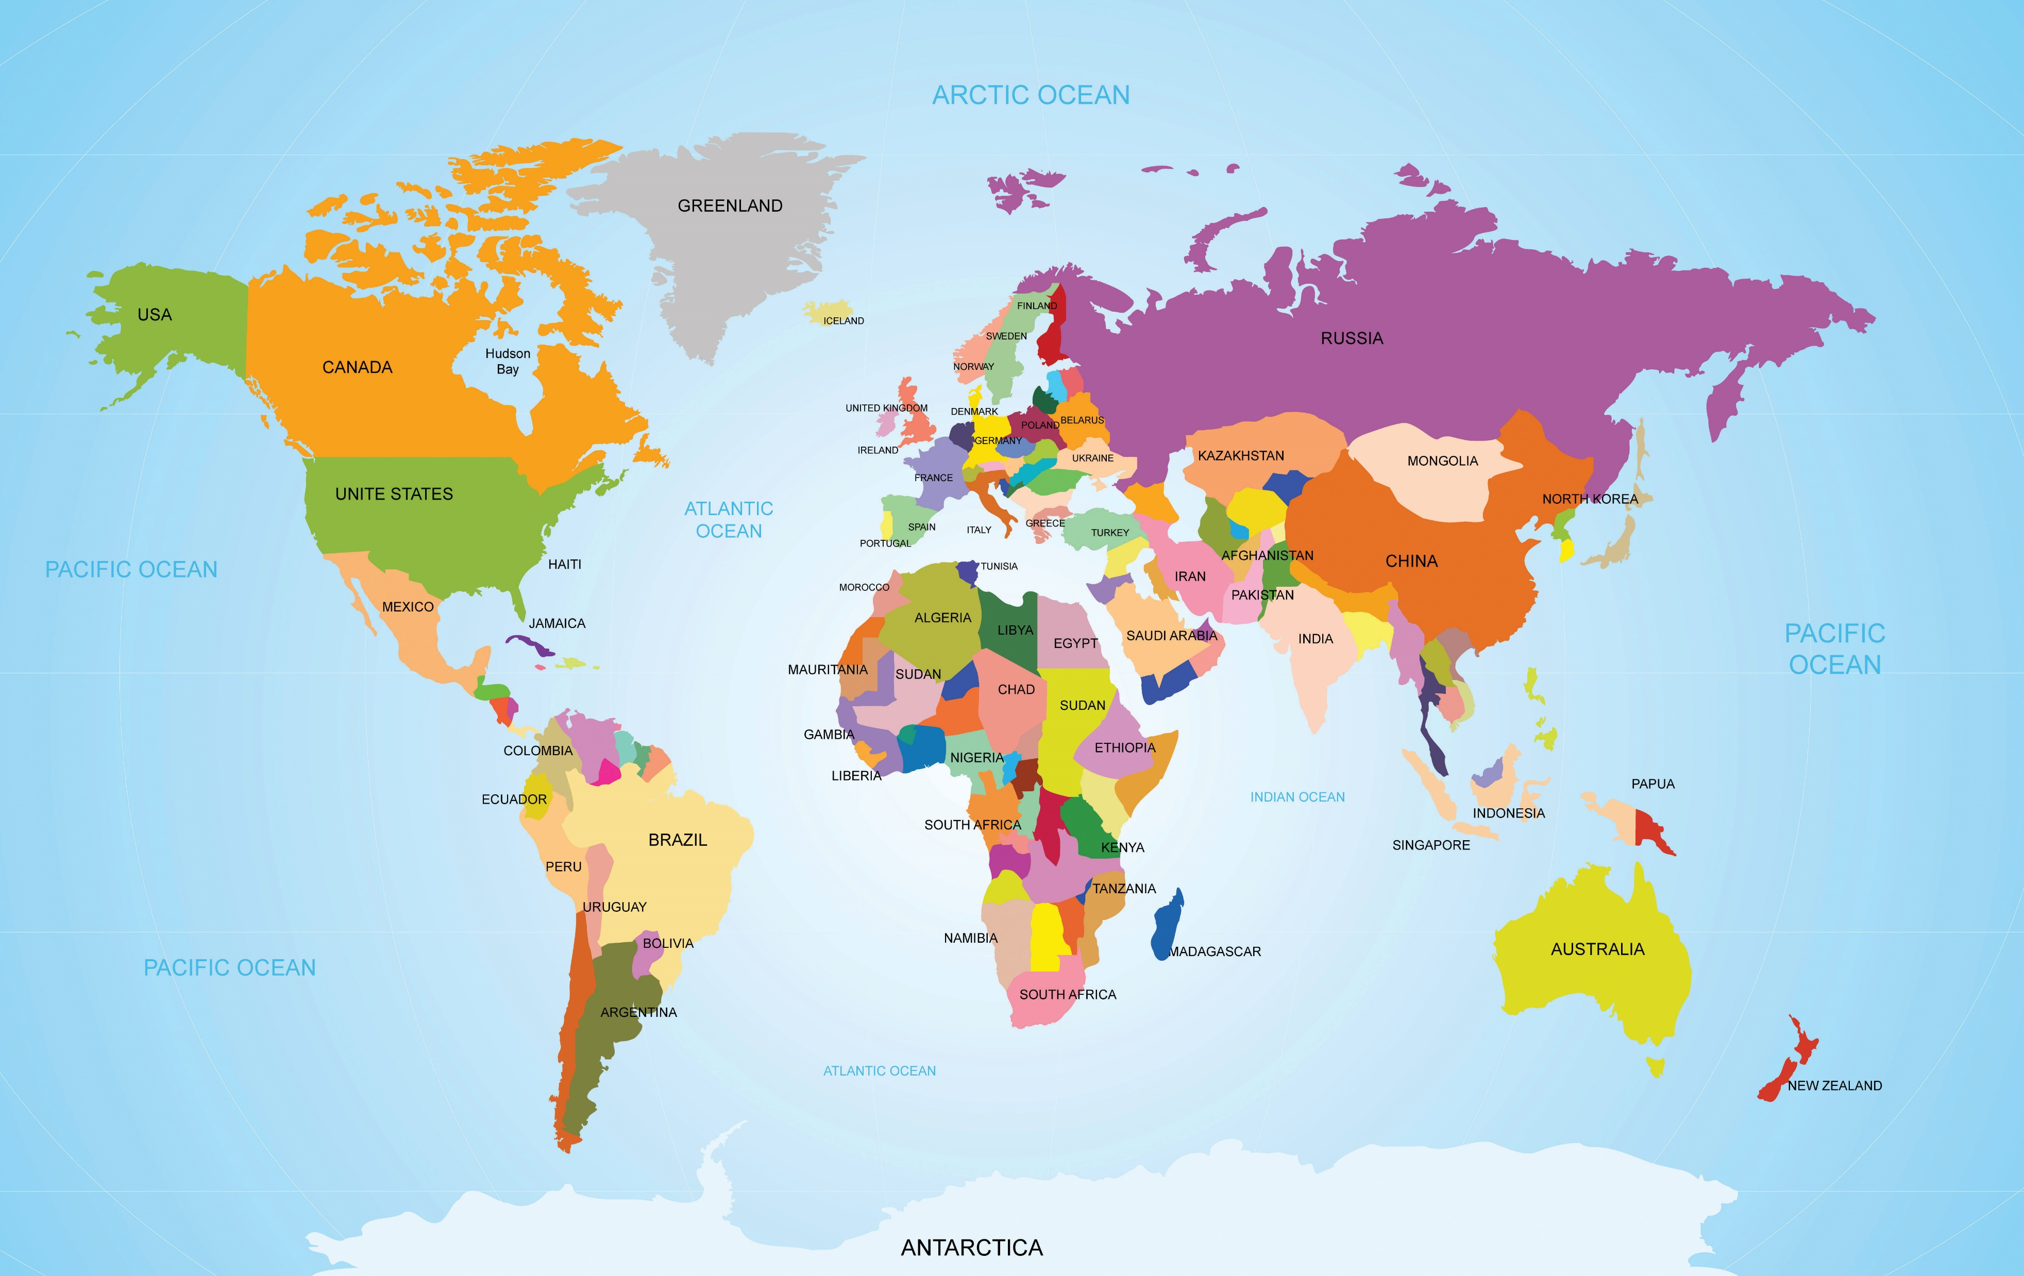
Juline’s research focuses on the Middle East and North Africa (MENA) region, while Polina has studied the role of language in migration to Russia from other post- Soviet countries.
By New Africa

Slide 24
TALKING POINTS
What do you think are the pros and cons of setting migrants a language test in order to get a work visa?
Why are support networks so vital for migrants?
How do you think the Islamic State used language to break the geographical borders? What do you think language allowed IS to do?
Juline says communities are shaped by language. To what extent do you agree, and why?
By Good Studio

Slide 25
THE TRANSLINGUAL

Slide 26
The translingual strand is related to how enhanced global connectivity is fostering the creation and maintenance of communities defined by their ability to cross boundaries between languages.
By Good Studio

Slide 27
DR NAOMI WELLS ROLE ON PROJECT: POSTDOCTORAL RESEARCH ASSOCIATE, DIGITAL HUMANITIES AND TRANSLINGUAL COMMUNITIES CURRENT ROLE: LECTURER IN ITALIAN AND SPANISH WITH DIGITAL HUMANITIES/CO-DIRECTOR OF THE DOCTORAL CENTRE INSTITUTE OF MODERN LANGUAGES RESEARCH/ DIGITAL HUMANITIES RESEARCH HUB SCHOOL OF ADVANCED STUDY, UNIVERSITY OF LONDON, UK
“My research aims to help us better understand how multilingual individuals and groups use the internet and social media to communicate and represent their identities and interests. While people have always moved across languages in their daily lives, the internet provides new ways for people to use and mix languages, and to communicate and share media content with speakers of different languages around the world.”

Slide 28
“It is important to recognise the ways the internet and social media can help us to stay connected. They also strengthen our feelings of belonging to our close community of family and friends, as well as new communities we can form online.
Latin American communities’ digital presence has increased the visibility of the community in the UK. While Latin Americans have been one of the fastest growing communities in London in the past decade, their interests and concerns have often been politically and socially marginalised. Online communications can help to build networks of people with shared interests and feelings of solidarity.
My research is revealing that the internet and social media provide new ways for people to express their sense of belonging to a community, but also greater possibilities to identify with and move across different communities. For example, someone might use a Spanish-language hashtag to show they belong to the Latin American community, but then switch to English for most of their communications. This is particularly true for young people who have grown up in the UK mainly using English with their friends online and offline, but for whom Spanish remains important for expressing their belonging to the Latin American community.
One of the most valuable experiences has been the experience of studying, working and conducting research abroad. This was important not just for improving my language skills, but also for developing the ability to live and work across different languages and cultures, and for learning to be adaptable and open to the different perspectives and experiences that people may bring.”

Slide 29
TALKING POINTS
How important is social media to you and your sense of identity?
Why do you think Spanish remains important for members of the Latin American community living in the UK?
“CROSS-LANGUAGE DYNAMICS: RESHAPING COMMUNITY” is a huge and varied research programme. What has it revealed to you about language and community?
If you were a researcher on this project, which of the three strands would you like to focus on, and why? What would you like to explore within your strand?
By Good Studio

Slide 30
THE POWER OF MODERN LANGUAGES
“There is a tendency to view modern languages as providing little more than practical knowledge for use in business and diplomacy. This, of course, is important, but the subject is so much more than a useful skill. It is worth studying for the unique insights it offers into other cultures, mindsets and value systems. Knowledge of multiple languages is a source of huge creativity and talent within the arts. It fosters wellbeing within individuals, and within and across entire communities. Modern languages provides a distinctive perspective on international conflict, cross-community cohesion and intercultural understanding. We should stop seeing the subject as an exotic and peripheral ‘add on’ to the core curriculum, and recognise that, with its focus on communication and what it means to be ‘different’, it represents the essence of humanities.”
– Stephen

Slide 31
THE POWER OF MODERN LANGUAGES
“The range of career options open to modern linguists is much broader than those on offer in the world of commerce, or translation, important though these are. With ever-increasing migration movements, management of diversity – for example – is becoming critical to national and local policymaking within individual countries. There is also a growing appreciation of the benefits of multilingualism to public health and creativity in the arts. For those who choose to study a language at university, the year they spend abroad practising and honing their linguistic skills becomes the defining year of their lives. This was certainly my experience!”
– Stephen

Slide 32
EXPLORE CAREERS IN MODERN LANGUAGES
Stephen suggests you should engage with speakers of the language you are interested in learning, as well as the cultures and societies you would like to learn more about. He recommends Target Jobs and the University of Manchester’s Language Careers page.
Open Days references university and college open days across the UK, which are good opportunities to engage with staff and students and investigate future academic prospects.
The Linguist List is a free resource that offers information about events and summer schools.
By vladayoung

Slide 33
PATHWAY FROM SCHOOL TO MODERN LANGUAGES
By denisismagilov
“The pathway into a modern languages research career is, as for other subjects, usually via a PhD. Because, by its nature, the study of languages is closely interconnected with that of other disciplines, and because the relative status of different languages is changing all the time, my top tip would be to remain flexible when identifying your PhD topic,” explains Stephen.
“Study more than one language and be prepared to acquire brand new ones; your existing linguistic experience and skills will serve you well. Take an interest in other humanities disciplines, depending on your own preferences and talents. The best PhDs (and the most successful research careers) are driven by sheer intellectual curiosity and passion. So, whilst following these tips, trust your own intuitions, instincts and interests.”

Slide 34
THE TEAM’S TOP TIPS
01 – Learning a language is a long, hard slog! The novelty value at the start of the journey wears off quite quickly and those long evenings spent learning obscure grammatical rules can seem pointless, especially when one is still struggling to hold a conversation in the language in question. The key is stamina, perseverance, and keeping your eye on the end goal.
02 – Don’t worry about not having an aptitude for language learning. Being good at languages comes with practice and time. Own your learning journey and be gentle with your mistakes. And most importantly, believe in yourself.
03 – Get involved in language-related projects or organisations as early as possible. Such opportunities will allow you to gain valuable experience and skills, and explore the richness and complexities of languages and ‘communities’ on your doorstep.
By vladayoung

Slide 35
TALKING POINTS
To what extent do you agree with Stephen’s view of modern languages? What have you gained from studying modern languages?
Stephen mentions several career options. Which interest you and why?
How would you feel about spending a year abroad as part of your study? What rewards and challenges would it offer you?
Where do your intellectual curiosity and passion lie?
Which of the team’s tips is most useful for you, and why?
By Good Studio

Slide 36
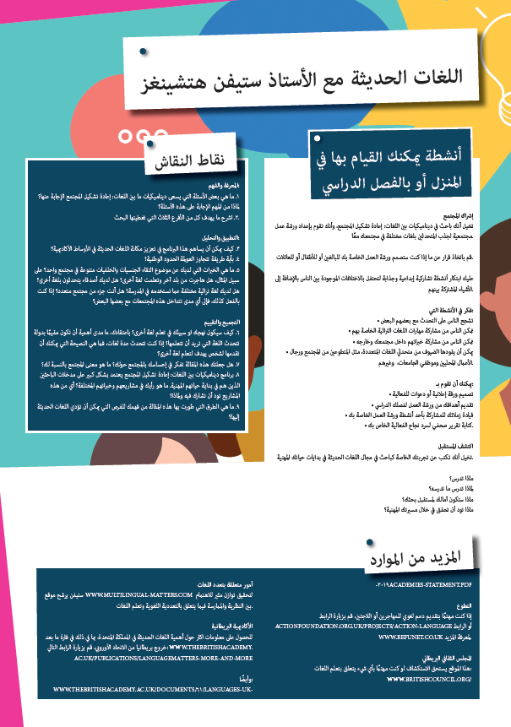
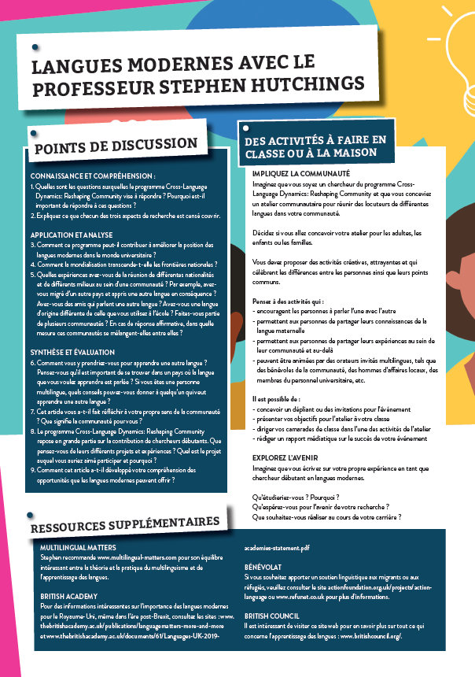
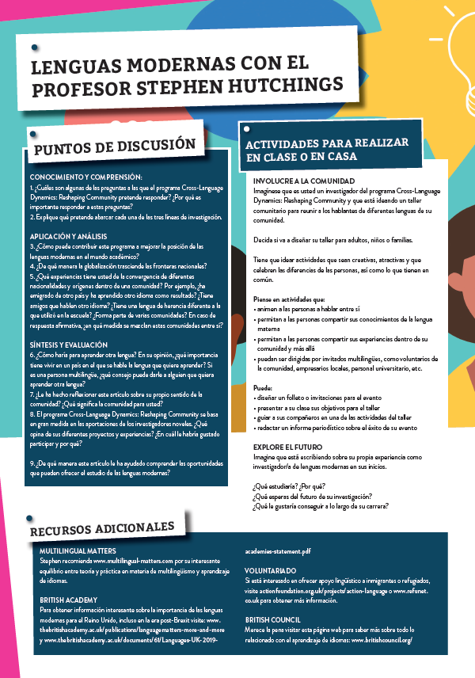
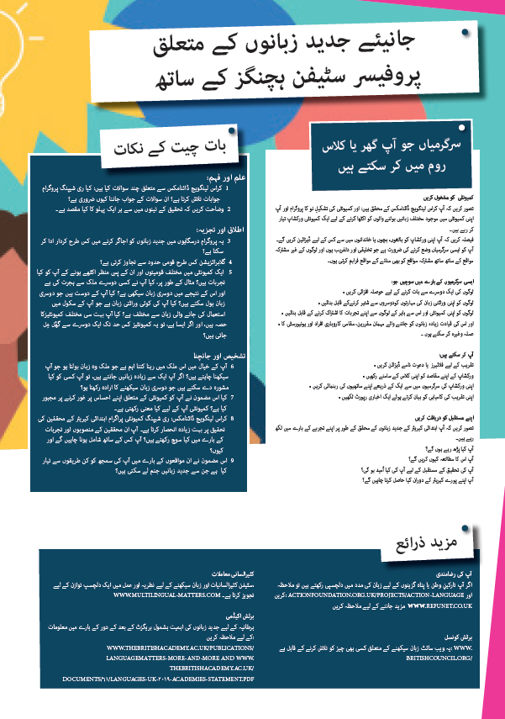
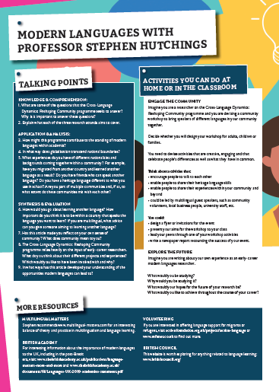
You can read about Stephen’s research in Arabic, French, Spanish, Urdu and English:
Download the activity sheet:

